Slide 1
Complexity Analysis

Slide 2
Complexity Analysis
Complexity Analysis determines the amount of time and space required to execute an algorithm.
It is used for comparing different algorithms
How to measure complexity?
Time Complexity
Amount of time taken, by an algorithm f(n) to run on the given input size, n.
Space Complexity
The amount of memory required by an algorithm f(n) to run on the given input size, n.

Slide 3
To calculate Time taken:
Steps:
For each instruction of the algorithm, calculate the total time required for execution
Determine the time needed to execute each operation, cost, c unit time
Determine the number of times each instruction is executed when the program is run
Sum up all the times to get a running time of the program

Slide 4
Primitive Operations
Low-level instruction
Have a constant execution time, or 1 unit time
Assigning a value to a variable (a = 3)
Following an object reference
Performing an arithmetic operation (a + b)
Comparing two numbers (a > b)
Accessing a single element of an array by index a[2]
Calling a method
printf(….), scanf
search(arr, 3)
Returning from a method return value

Slide 5
Constant Function
f(n) = c
It doesn’t matter what n is. This piece of code takes a constant amount of time to run. It’s not dependent on the size of n.
void sum (){
int a = 22;
int b = 23;
int c = a + b;
printf(“%d”, c);
}
cost
# of times instruction is executed
Total time
1
1
1
1
1
1
2
1
2
1
1
1
f(n) = 5

Slide 6
Exercise
Inspect the code. Determine the running time of the function. Clearly specify the cost of execution and number of times each instruction will take.
float foo(float x, float y) {
printf..
printf..
return..
}
f(n) = 3
Is it dependent on n?

Slide 7
Exercise
Determine the running time of the function. Clearly specify the cost of execution and number of times each instruction will take. Arrive at T(n).
void foo(double x) {
double z, y = 1.0;
for (int i = 1; i < 100000000; i++)
z = y*x;
}
Once
With cost = 1
10⁸ times
Each with cost = 1
Total = 10⁸
10⁸ -1 times
Each with cost = 2
Total = (10⁸-1) * 2
f(n) = 1 + 1+ 10⁸ + (2 *10⁸) -2 + (2 *10⁸) -2
= 5 * 10⁸ -2
Is it dependent on n?

Slide 8
Meaning of Linear function
n
Look at f(n) = n
Linear relationship between n and
time to complete the function
If n= 1 and running time is 1 sec, then when
To previous, Add 10 times elements n = 10, running time = 10 secs i.e. 10 times more than previous
To previous, Add 100 times elements n = 1000, running time = 1000 secs i.e. 100 times more than previous
…..

Slide 9
Linear function
f(n) = n
int [] foo(int n) {
int x = 2;
int y = 3; int z[1000000];
for (int i = 1; i < n; i++)
int z[i] = y*x;
return z;
}
f(n) = 5n-1
Notes:
1+1+1+n+2n-2+3n-3+1

Slide 10
Complexity and Tractability
Assume the computer does 1 billion operations per sec.

Slide 11
Linear function
f(n) = n
int [] foo(int n) {
int x = 2;
int y = 3; int z[1000000];
for (int i = 1; i < n; i++)
int z[i] = y*x;
return z;
}
Do we need this
level of detail??????
NO
f(n) = 5n-1

Slide 12
Asymptotic Notation
Big picture approach
The growth rate is not affected by
Constant factors
Lower order terms
n is linear
5n is still linear
10²n +2 is still linear ?
5, 10² and 2 are constant factors
This means ignore constant factors
F(n) = 5n

Slide 13
Quadratic Function
n²
f(n) = n²
Quadratic relationship between n and
time to complete the function
If n= 1 and running time is 1 sec, then when
To previous Add 10 elements , n= 10 and running time = 10² i.e. 100 times more than previous
To previous Add 100 times elements, n = 1000 running time = 1000² i.e. 1,000,000 times more than previous
…
DOES NOT SCALE WELL!!!
n

Slide 14
Some more perspective: Complexity and Tractability
Assume the computer does 1 billion operations per sec.

Slide 15
Asymptotic Notation: Coming back……
Big picture approach
The growth rate is not affected by
Constant factors
Lower order terms
Does n + n² behave linear?
NO.
Behaves more like n²
i.e. Quadratic
This means consider the higher order
terms and ignore the lower order terms
n²+n
n
n²

Slide 16
Asymptotic Notation
To arrive at the asymptotic notation:
Remove constant factors
Ignore the lower order terms
Three notations (actually six):
Big-Oh: Represents the Worst Case. Notation : O
The big-Oh notation gives an upper bound on the growth rate of a function
Big Omega: Represents the Best Case. Notation: Ω
The big-Omega notation gives an lower bound on the growth rate of a function
Big Theta: Represents the Average Case. Notation: Θ

Slide 17
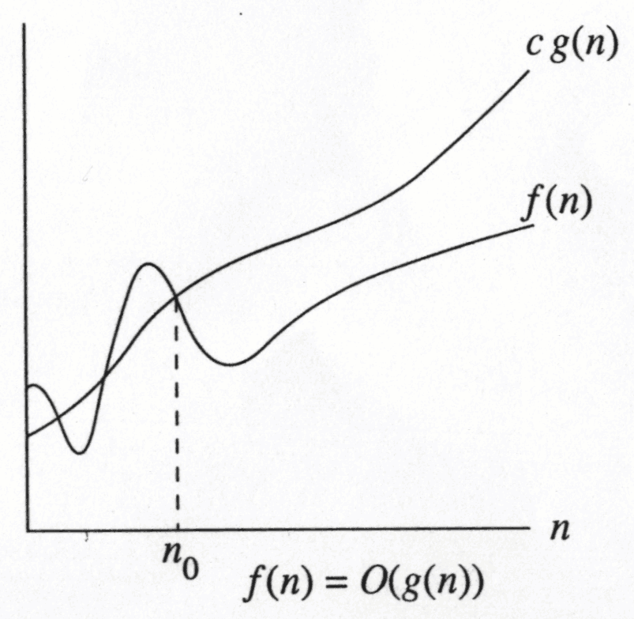
Big-Oh
The statement “f( n) is O (g ( n))” means that the growth rate of f( n) is no more than the growth rate of g ( n )
f(N) = O(g(N))
There are positive constants c and n₀ such that
f(N) ≤ c g(N) when N ≥ n₀
The growth rate of f(N) is less than or equal to the growth rate of g(N)
g(N) is an upper bound on f(N)
foo(n)
The idea is to establish a relative order among functions for large n
∃ c , n₀ > 0 such that f(N) ≤ c g(N) when N ≥ n₀
f(N) grows no faster than g(N) for “large” N

Slide 18
Big Oh
f(n): 2n+3
What is the Big-Oh order of the function?
Ignore constant terms remove 3
T(n) = 2n
2 is a constant, remove it left with n
Reduce lower order terms -
So, f(n) = O(n)
So what is g(n)?
f(2n+3) <= c.g(n)
2n+3 <= c.n
(c-2)n >=3
n>= 3/(c-2)
Suppose c=3 and n_{o} = 3
Reduce f(n): 2n²+2n to Big Oh Order.
f(2n²+2n) = O(n²)
Reduce n² to n ? NO
n² ≤ cn
n ≤ c Cannot be satisfied

Slide 19
Exercise
Inspect the code. What is f(n) in terms of order of n?
void foo(double x) {
double z, y = 1.0;
for (int i = 0; i < 100000000; i++)
z = y*x;
}
1
10⁸ times
10⁸ -1 times
Once
With cost = 1
10⁸ times
Each with cost = 1
Total = 10⁸
10⁸ -1 times
Each with cost = 2
Total = (10⁸-1) * 2
f(n) = 1 + 10⁸
= 10⁸
= O(1)

Slide 20
Exercise
Inspect the code. What is the asymptotic complexity of the code?
int linearSearch(int arr[], int n, int key) {
for (int i = 0; i < n; i++) {
if (arr[i] == key)
return i;
}
return -1;
}
f(n) = O(n) Worst Case: Key is either at the last position of the array or not present at all
f(n) = O(1) Best Case: Key found at the first position of the array. In this case, only one comparison is made.
f(n) = O(n) Average Case: Key might be located somewhere in the middle of the array,

Slide 21
Nested Loops
void foo(int n) {
for (int i = 1; i <= n; i++)
for (int j = 1; j <= n; j++)
printf(“%d\n”,i);
}

Slide 22
General Rules
Single For loops
at most the running time of the statements inside the for-loop (including tests) multiplied by the number of iterations.
Nested for loops
the running time of the statement multiplied by the product of the sizes of all the for-loops.
E.g. O(N²)
for (i=0;i<N; i++)
for (j=0;j<N;j++)
statement;

Slide 23
General Rules
Consecutive statements
Just add these
O(N) + O(N²) = O(N²)
IF-ELSE statements
never more than the running time of the test plus the larger of the running times of S1 and S2.
f(n) = O(max (f₁(n), f₂(n))
for (i=0; i<N; i++)
a[i]=0;
for (i=0; i<N; i++)
for (j=0; j<N; j++)
a[i]=a[i]+ a[j]+ i + j;
if (cond) then O(1)
S₁ f₁(n)
else
S₂ f₂(n)

Slide 24
General Rules
Method calls
A calls B
B calls C
etc.
A sequence of operations when call sequences are flattened
f(n) = max(f_{A}(n), f_{B}(n), f_{C}(n))

Slide 25
Loop incrementing/decrementing exponentially by factor 2
void foo(int n) {
for (int i = 1; i <= n; i=i*2)
printf(“%d\n”,i);
}
void foo(int n) {
int i = 1;
while (i <= n) {
printf(“%d\n”,i);
i=i*2;
}
}
O(log n)
void foo(int n) {
for (int i = n; i > 0; i=i/2)
printf(“%d\n”,i);
}
void foo(int n) {
int i = n;
while (i > 0) {
printf(“%d\n”,i);
i=i/2;
}
}
O(log n)

Slide 26
Loop incrementing by constant power
void foo(int n) {
for (int i = 2; i <= n; i= pow(i,c) )
printf(“%d\n”,i);
}
O(log(log n))

Slide 27
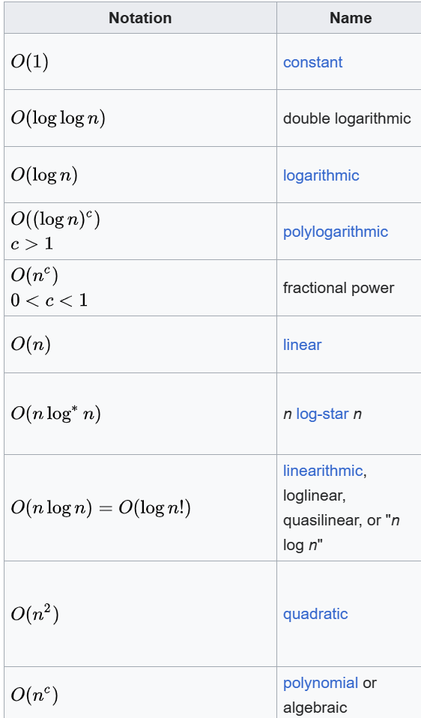
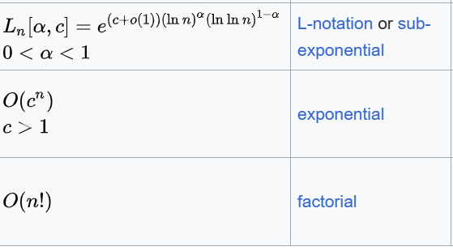
Order of functions

Slide 28
Loops: Different Patterns
void foo(int n, int m) {
for (int i = n/2; i <= n; i++)
printf(“%d\n”,i);
for (int i = 1; i <= m; i++)
printf(“%d\n”,i);
}
O(n+m)
void foo(int n, int m) {
for (int i = 1; i <= n; i++)
for (int j = 1; j +m/2 <= m; j++)
printf(“Hello World”);
}
O(nm)
Notes:
O(n+m)
O(nm)

Slide 29
Quick Exercise:
void foo(int n) {
for (int i = n/2; i <= n; i++)
for (int j = 1; j +n/2<= n; j++)
for (int k = 1; k <= n; k=k*2)
printf(“Hello World”);
}
O(n²logn)
void foo(int n) {
for (int i = 1; i <= n; i++)
for (int j = 1; j < i; j++)
printf(“%d\n”,i);
}

Slide 30
Complexity of Array and Linked List
Operation
Array
Linked List
Access
Search
Insertion (At beginning) :
Insertion (At End) :
Insertion (At given position) :
Deletion (At beginning) :
Deletion (At End) :
Deletion (At given position) :
O(1)
O(n)
O(n)
Space available: O(1)
Space not available: O(n)
O(n)
O(n)
Space available: O(1)
If resized: O(n)
O(n)
O(n)
O(n)
O(1)
O(n)
O(n)
O(1)
O(n)
O(n)

Slide 31
Complexity and Tractability
2^{n}
n²
n³
n log n
n
log n

Slide 32
Complexity and Tractability
Suppose each operation takes 1ns, how much time will it take to sort 1
Billion customer if algorithm with time complexity of n^2 is chosen?
1hr= 3.6 * 10 ¹² ns
1day= 8.64 * 10¹³ ns
1week= 6.05 * 10¹⁴ ns
1month= 2.62 * 10¹⁵ ns
1year= 3.15 * 10¹⁶ ns
Big bang = 4.32 * 10²⁶ ns

